Slide 1
Embedding Mathematical Language and Discourse into Mathematics Lessons Primary Maths Conference 2022
Carmel Delahunty
Judy Gregg
Friday 10 June 2022
Notes:
11.55 am – 12.00 pm (5 mins)
Slides 1-3
Carmel

Slide 2
Warm Up - Which one doesn’t belong?
Notes:
11.55 am – 12.00 pm (5 mins)
Slides 1-3
Carmel
Participants stand in the corner under the picture of the one they think does not belong
Language to describe which one does not belong and why.

Slide 3
Overview
Number Talks
Talk Moves
Activity – ‘Numerous Connexions’
Tier 2 and Tier 3 Language, and ‘Exploratory Talk’
Lesson Objectives Incorporating Mathematical Language
5) Summary and Suggested Action Plan
Notes:
11.55 am – 12.00 pm (5 mins)
Slides 1-3
Carmel

Slide 4
What are ‘Number Talks’?
‘Number Talks are a brief daily practice where students mentally solve computation problems and talk about their strategies.’
‘It is about helping students learn to work flexibly with numbers and arithmetic properties.’
‘Helps them build a solid foundation, and confident disposition for future mathematics learning.’
Humphreys, C & Parker, R (2015)
Notes:
12.00 pm – 12.10 (10 mins)
Slides 4-10
Judy

Slide 5
Why use ‘Number Talks’?
Number Talks promote facility with arithmetic. This helps develop Fluency (which by definition includes ‘flexibility’)
Hand signals are used to assist with the process of Number Talks, and ‘Talk Moves’ facilitate the procedure.
Procedure
Students put one fists on their chest to indicate that they are ready to participate
A problem is written on the board (generally in a horizontal fashion)
Students solve the problem and put up their thumb when they have had enough time to think, and they have an answer and a strategy.
Notes:
12.00 pm – 12.10 (10 mins)
Slides 4-10
Judy

Slide 6
Why use ‘Number Talks’? (cont.)
4. When enough thumbs are up the teacher asks volunteers for
answers and records these on the board.
5. The teacher then asks if anyone is willing to share how they got
their answer, and records this student’s thinking.
6. Students identify the answer they are defending (if more than
one answer is given).
7. The teacher can build on this by asking the other students
questions.
Notes:
12.00 pm – 12.10 (10 mins)
Slides 4-10
Judy

Slide 7
Number Talk Hand Signals
Notes:
12.00 pm – 12.10 (10 mins)
Slides 4-10
Judy

Slide 8
Planning a Number Talk
Anticipate different strategies students might use for solving a problem.
How will you record each of their strategies?
What questions might you ask to fully understand and represent a student’s thinking?
Upon reflection, what do you want to remember; what problem might you do next, and why?
Humphreys, C & Parker, R (2015)
Notes:
12.00 pm – 12.10 (10 mins)
Slides 4-10
Judy

Slide 9
Solve this problem
18 x 7
How many different ways can you solve this in your head?
Calculate the product of 18 and 7 in your head
Record what you did
Find an alternative strategy; record this strategy too
Notes:
12.00 pm – 12.10 (10 mins)
Slides 4-10
Judy
Work on this problem and share your strategies with others.
Did you discover a new strategy you could use to solve the problem that you hadn’t thought of before?
Get a couple of ideas and write these up
Number talk posters
Carmel show examples, and BRIEFLY explain where they fit in a lesson

Slide 10
Thinking Routine
Connect
Extend
Challenge
Notes:
12.00 pm – 12.10 (10 mins)
Slides 4-10
Carmel (if needed)
Group participants in teams of 3 – Discuss messages from keynote
Connect – what did you learn about NTs that connected with what you already knew
Extend – what did you learn that was new for you with regard to NTs
Challenge – what questions did you still have about NTs

Slide 11
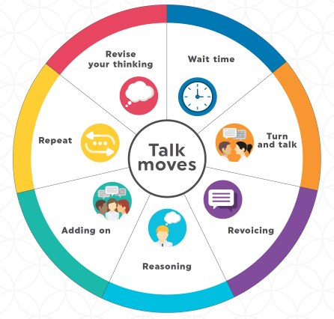
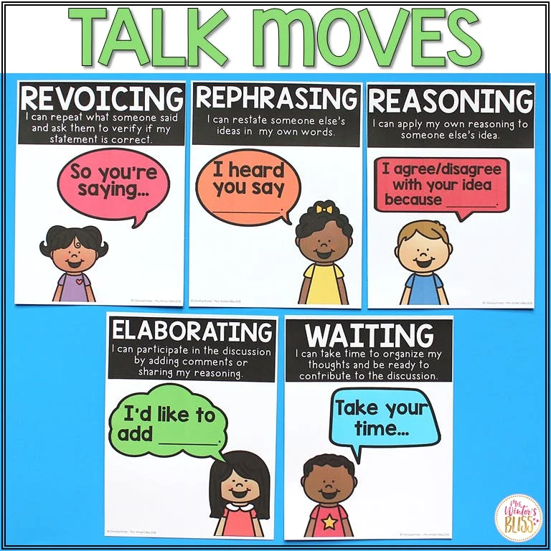
Talk Moves
Notes:
12.10 pm – 12.20 (10 mins)
Slides 11-20
Judy

Slide 12
Talk Moves Suzanne Chapin & Catherine O’Connor
The purpose of ‘Talk Moves’ is to promote discourse in the Mathematics classroom
While ‘Talk Moves’ can be used during ‘Number Talks’, they can also be used during other areas of the Mathematics curriculum
The goals of Talk Moves are to help students:
share, expand and clarify their own thinking
listen carefully to one another
deepen their reasoning
think with others
Notes:
12.10 pm – 12.20 (10 mins)
Slides 11-20
Judy

Slide 13
Talk Moves: ‘Revoicing’
Restating a previous speaker’s comment (either the teacher or a student), and saying, ‘Is this correct?’
helps students to clarify their thinking and improve their understanding
is used to highlight an important idea, or to reveal a misunderstanding
Notes:
12.10 pm – 12.20 (10 mins)
Slides 11-20
Judy

Slide 14
Talk Moves: ‘Repeating’
The teacher asks a student to repeat what another student said. By repeating, students are forced to reflect on the ideas, and are pushed to make sense of the contribution.
promotes that the discussion is between everyone
highlights an important contribution
slows the pace when concepts are complex
Notes:
12.10 pm – 12.20 (10 mins)
Slides 11-20
Judy

Slide 15
Talk Moves: ‘Reasoning’
Ask students the following questions: ‘Do you agree/disagree? Why?
elicits students to reason (If used frequently, students will learn to just explain without prompts.)
useful for clarifying meaning
exposes students to the thinking of others, expanding their own perspectives
Notes:
12.10 pm – 12.20 (10 mins)
Slides 11-20
Judy

Slide 16
Talk Moves: ‘Adding On’
Ask students: ‘Can anyone add on to this conversation?
elicits contributions from others (Sometimes their contributions may be repetitive, but this is okay.)
a good way to engage students
helps build conversation, and promotes deeper reasoning
Notes:
12.10 pm – 12.20 (10 mins)
Slides 11-20
Judy

Slide 17
Talk Moves: ‘Teacher Wait Time’
After posing a question allow plenty of time. (Three seconds is not enough time!)
ensures that students have enough time to think about their response
allows students to organise their thoughts
allows for more considered responses
Notes:
12.10 pm – 12.20 (10 mins)
Slides 11-20
Judy

Slide 18
Talk Moves: ‘Turn and Talk’
Provides opportunities for students to:
share ideas, and to build their confidence
rehearse and clarify their answers or responses before they share these ideas with the larger group
(Ref: NSW Department of Education)
Notes:
12.10 pm – 12.20 (10 mins)
Slides 11-20
Judy

Slide 19
Talk Moves: ‘Revise Your Thinking’
This provides an opportunity for students to reflect on and review their own ideas and learning.
This says to students that it is acceptable to change your thinking once new knowledge or information becomes available and understood.
(Ref: NSW Department of Education)
Notes:
12.10 pm – 12.20 (10 mins)
Slides 11-20
Judy
To be effective and useful, ‘Talk Moves’ need a learning environment conducive to collaborative problem-solving. This can be considered in terms of rights and obligations. (Next slide)

Slide 20
Talk Moves Practice
Work on the following problem:
I am thinking of a number…
If I divide it by 2 there is a remainder of one
If I divide it by 3 there is a remainder of two
What might my number be?
Once everyone has worked it out, take turns sharing your answer and your strategy.
While one person is sharing, the others in the group choose one Talk Move and practice it:
Revoicing Repeating Reasoning Adding on Wait time Turn & Talk Revise Thinking
Notes:
12.10 pm – 12.20 (10 mins)
Slides 11-20
Judy
Teams of 5

Slide 21
Numerous Connexions
Notes:
12.20 pm – 12.25 (5 mins)
Slide 21
Carmel
Carmel – participants in pairs match cards – Discuss the consideration that symbols are also ‘language’.
https://www.200hours.com.au/numerous-connexions

Slide 22
See Say Hear Write (Order)
Mathematical Discourse
Productive language – writing and speaking
Receptive language – listening and reading
(Ref: Boaler, 2016, in Van de Walle et al. 2019)
Strategies such as Number Talks and Talk Moves are are opportunities for students to see, say, hear, (and order, in the case of measurement) mathematical vocabulary in mathematical discourse.
Opportunities for writing mathematical vocabulary can be added to these strategies. How? What other strategies do you use to elicit the use of Tier 2 and Tier 3 language in written form?
Notes:
12.25 pm – 12.35 (10 mins)
Slides 22-26
Carmel
Jo Boaler proposes that mathematical discourse needs to include both receptive language and productive language.
Activity
Which do you think is developed first – productive language or receptive language? Why? Of which do you have the most evidence in your classrooms?

Slide 23
Tiers of Mathematical Vocabulary
We understand that vocabulary can be categorised into three ‘tiers’:
Tier 1: words that include everyday words encountered in general conversation (and therefore do not need to be taught)
Tier 2: words that are found in written texts across multiple topic and subject areas, but appear infrequently in oral language conversations; they vary according to context and discipline, e.g., solution, pattern, prime
Tier 3: include the content words of subject domains. Vocabulary specific to a subject is often called ‘technical vocabulary’ e.g., circumference, rhombus, denominator
(education.vic.gov.au; www.corwin.com. 2017)
Notes:
12.25 pm – 12.35 (10 mins)
Slides 22-26
Carmel
Sort words – Tier 2 & Tier 3

Slide 24
Tier 2 and Tier 3 Language
Focused explicit teaching on Tier 2 words and, when required, Tier 3
words, produces the best outcomes for students
(Beck, McKeown and Kucan, 2013).
Studies have shown that where a higher density of technical mathematical
vocabulary is identified, the density of exploratory talk will also be greater,
and higher levels of critical thinking will be adopted (as per the Australian
Curriculum cross curricular strand, and General Capability: Numeracy)
(Symons & Pierce, 2019)
Notes:
12.25 pm – 12.35 (10 mins)
Slides 22-26
Carmel
Let’s have a look at productive talk. Exploratory talk in an example.

Slide 25
Productive Talk
Mercer and Wegerif (1999) identified three broad talk types when they analysed many hours of videotaped discussion amongst British primary age students:
Disputational talk is characterised by disagreement and individualised decision making.
Cumulative talk occurs when speakers build positively, but uncritically, on what the other has said. (Talk Moves: ‘Adding on’; ‘Repeating’; ‘Revoicing’)
Exploratory talk occurs when partners engage critically, but constructively, with each other’s ideas. (Talk Moves: ‘Reasoning’; ‘Revoicing’)
Notes:
12.25 pm – 12.35 (10 mins)
Slides 22-26
Carmel
1. (Self explanatory)
2. We have provided strategies for encouraging cumulative talk in the discussion of Talk Moves, e.g., Adding On, Repeating, Re-voicing
3. The use of strategies such as Reasoning and Re-voicing and Revise Thinking encourage exploratory talk. Productive talk that is exploratory is the aim in mathematics sessions.
Let’s have a deeper look at exploratory talk.

Slide 26
Exploratory Talk
Critiques are constructive and contain logical arguments, e.g. ‘You could have also used near doubles, because double 19 is nearly 40.’
Feedback includes specific observation e.g., We like how you used the area of the rectangle to calculate the total area of that polygon.
Questioner asks questions indicating a specific need that requires addressing, e.g. To get the perimeter, do we add the lengths of the sides?
Answer to problems includes description of thinking behind the contribution (reasoning) e.g., The next one could be red, because we have already drawn out five blue Smarties.
Notes:
12.25 pm – 12.35 (10 mins)
Slides 22-26
Carmel
Logical arguments, specific observations, specific needs, and reasoning are all characteristics of exploratory talk. Note the Tier 2 and 3 language in these examples.

Slide 27
Mathematical language objectives
‘It is through assessment that society provides or withholds its rewards’
(Ref: Clarke, 1996, p 329 in Siemon et al., 2015)
If we are to explicitly teach vocabulary,
and teach mathematical discourse,
then we need to include language objectives
(as well as content objectives)
in our planning of lesson aims, and assessment.
Notes:
12.35 pm – 12.45 (10 mins)
Slides 27-29
Carmel
We believe we assess what we value, and this sends a very strong message to students.
Do your lesson objectives include the means by which students can demonstrate their new knowledge, skills and understanding through productive language and receptive language?
We are now going to look at some learning objectives that show how you could include language objectives. You may like to use the next slide in a collaborative planning situation and work through it much more slowly than I will in this instance.

Slide 28
Language and Discourse in the Aim of a Lesson
By the end of this lesson, the students will have sorted numbers into similar groups. Examples: odds and evens; 2-digit and 3-digit numbers
By the end of this lesson, the students will have justified the groups of numbers they have created. Example: “I have put all these numbers together because I can make them with 10s and 1s."
By the end of this lesson, the students will have used mathematical reasoning to identify and explain others’ strategies for grouping numbers. Example: “Ravi put those numbers together because they are all even numbers, and he put all these together because they are not even numbers.”
Notes:
12.35 pm – 12.45 (10 mins)
Slides 27-29
Carmel
SHOW FIRST EXAMPLE
Look at these examples of statements for the aim of a lesson
SHOW 2ND EXAMPLE
2. Compare the first and second example. What’s the same? What’s different?
SHOW 3RD EXAMPLE
3. Compare the second and third example. What’s the same? What’s different?
Which aspects of receptive and productive language are included in the third example?
What proficiencies does this address?
Which vocabulary is Tier 1, 2 and 3?
Activity:
Access the Victorian Curriculum Scope and Sequence. For your year level, choose a content descriptor from Number and Algebra, and one from Statistics and Probability. Write a lesson aim/objective that includes a language objective for each descriptor.

Slide 29
Language and discourse in the aim of a lesson
By the end of this lesson, the students will have sorted shapes. (Example: regular and irregular shapes.)
By the end of this lesson, the students will have classified polygons according to common characteristics. (Example: number of lines)
By the end of this lesson, the students will have verbally critiqued their peers’ justifications of their classification of polygons by listening to explanations of their Venn diagrams. (Examples: number of right angles; composite shapes)
Notes:
12.35 pm – 12.45 (10 mins)
Slides 27-29
Carmel
SHOW FIRST EXAMPLE
Look at these examples of statements for the aim of a lesson
SHOW 2ND EXAMPLE
2. Compare the first and second example. What’s the same? What’s different?
SHOW 3RD EXAMPLE
3. Compare the second and third example. What’s the same? What’s different?
Which aspects of receptive and productive language are included in the third example?
What proficiencies does this address?
Which vocabulary is Tier 1, 2 and 3?
Following some work on this, we invite you to consider an additional activity:
Access the Victorian Curriculum Scope and Sequence. For your year level, choose a content descriptor from Number and Algebra, and one from Statistics and Probability. Write a lesson aim/objective that includes a language objective for each descriptor.

Slide 30
‘Ready Steady’ Godfrey, C. (2018) Three Fluency Activities: Ready, steady, add. Prime Number, 33 (1) Photo used with permission.
Two students sit/stand facing each other.
With clinched fists they say “Ready Steady…” (as for Rock Paper Scissors) and on the third beat show any number of fingers and say “Subitise!”
Students must say their partner’s number.
Notes:
12.45 pm – 12.50 (5 mins)
Slide 30
Carmel
Variations: add, difference, product
Also: Make Me 5

Slide 31
Summary and Action Plan
Number Talks
Number Talk hand signals
Number Talk examples
Talk Moves: (Re-voicing, Repeating, Reasoning,
Wait Time, Adding On, Turn & Talk,
Revise Your thinking)
Tier 2 and Tier 3 language
Exploratory Talk
Productive and receptive language
Lesson objectives that include language objectives
Games: Ready Steady, Make Me 5
Share with a colleague in my teaching team
Discuss with School Maths Leader (SML)
Share how I am establishing/have established this in remote learning
Find more examples of these
Ask my SML to share their recent learning about this
Watch/read this again
Read more about this
Trial this tomorrow!
Practice this with my students
Include this in my planning
Share my new learning about this in an email
Notes:
12.50 pm – 12.55 (5 mins)
Slide 31
Carmel
On the left-hand side of this slide are aspects we have covered in this presentation, and on the right-hand side, suggested actions. So, as a way to summarise the information in this presentation, and as a suggestion for further learning, we invite you at some stage very soon, to link each aspect on the left-hand side with an action on the right-hand side. (We have provided an example.)
THANKS FOR CHOOSING THIS WORKSHOP.
BEST OF LUCK WITH YOUR CONTINUED WORK, IN YOUR DEVELOPMENT OF MATHEMTICAL LANGUAGE AND DISCOURSE WITH YOUR COLLEGAUES AND STUDENTS.

Slide 32
Additional Resources

Slide 33
Number Talk Examples
Derrimut Primary School – Number Talk with Preps
https://fuse.education.vic.gov.au/Resource/LandingPage?ObjectId=f9c5da5f-b8bf-48b2-a5e9-70d00aec403e&SearchScope=All
Fifth Grade Division Number Talk (U.S.A)
https://www.youtube.com/watch?v=DQtgFaVqv7c
Notes:
These are two examples of Number Talks in action – one junior and one senior example.

Slide 34
Talk Moves
For more information and detail about Talk Moves from the NSW Department of Education, please go to the following link:
https://education.nsw.gov.au/teaching-and-learning/curriculum/key-learning-areas/mathematics/Early-Stage-1-to-Stage-3/resources

Slide 35
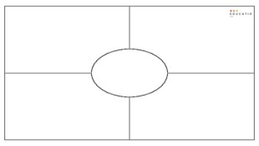
Other Strategies
Think Board
Maths' vocabulary word in the middle. The other sections can be labelled:
Symbol
Meaning (draw or describe)
Action with concrete materials
Contextual Example (written, drawn or demonstrated)

Slide 36
Supporting discourse and language
Notes:
There are many strategies, that support the development of rich mathematical discourse. Consider using graphic organisers (e.g., Frayer Model) to support students’ speaking (productive language) rather than them being a single end in themselves.

Slide 37
Activities
Concept Cartoons/Speech Bubbles – Make three or four cartoon characters or bubbles. Each one states a definition of a Maths word (These could contain diagrams or symbols, or can be recorded). Only one definition is correct. The others may include student misconceptions. Students choose the correct answer, and say why this is correct (if they are able to). Students listen to each others’ responses.

Slide 38
Activities
Bingo – containing vocabulary word symbols (teacher calls out word and students put a counter on the symbol that represents that word)
Celebrity Heads – each person has a number on a sticky note on their back. Students ask questions. For example, ‘Am I more than 5?’ ‘Am I less than 10’
Pictionary/Charades – Maths word that students need to act out or draw. For example, ‘take away’. Student draws or acts someone taking something away.

Slide 39
‘Snot’
As for Hangman except students are given the first letter of a mathematical word and must offer suggestions for each letter working from left to right.
1. m _ _ _ _ _ _ _
2. m u _ _ _ _ _ _
Notes:
Teacher records each suggestion e.g., mi and responds ’It could be, but it’s not’, if incorrect. Teacher can ask if next letter is likely to be a vowel or consonant; teacher can begin by giving students a clue for the word.

